Slide 1



Team C.A.R.E
“Developing a cost and survival prediction application to improve patient decision making and planning for cancer treatment”
Notes:
Greet prof
We are Team Care
Intro yourself I will be going through the project background

Slide 2
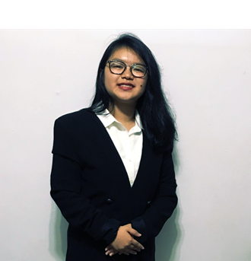






Team C.A.R.E
Jesslyn Chang
(Frontend, Secretary)
Tan Jia Yun
(Frontend, Secretary)
Tanny Lai
(Frontend, Graphic Designer)
Prof. Akshat Kumar
(Project Supervisor)
Justin Choy
(Backend, Project Manager)
Chua Ming Yu
(Backend, Solution Designer)
Guo Ling Xing
(Backend, Solution Designer)
Notes:
These are the members of team care

Slide 3




Key Stakeholders (NCCS)
Dr. Wong Fuh Yong
(Senior Consultant)
Fong Mun Yee
(Lead Coordinator)
Gan Soon Ann
(Lead Informatician)
Phyu Nitar
(Clinical Analyst)
Notes:
& key stakeholders for our project

Slide 4
Agenda
Project Background
Requirements & Progress
Project management
Technical details and Quality of the product
Future Works
Notes:
Agenda for today

Slide 5
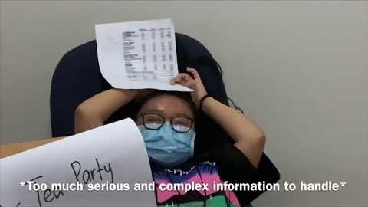
Project Background
Notes:
https://www.youtube.com/watch?time_continue=1&v=oe2nMp6TQAM&feature=emb_title
Next, we have a video that highlights the current issues that NCCS is facing
As you can see from the video, It would be good for patients to have more information for financial planning

Slide 6

Motivation & Value Proposition
“National healthcare spending in Singapore has almost tripled from $3.74 billion in 2010 to $9.8 billion in 2016 (2.2% of GDP). This is projected to reach $13 billion in 2020” – Basu, 2017
Notes:
As you can see from the quote, the cost of healthcare is rising, especially cancer treatment.
Thus, as said, It would be good for patients to have more info so they can do financial planning and make better informed decisions.

Slide 7


Project Strategy
Project Management:
Staged Waterfall
Bi-weekly/Weekly check on progress, risks & Stakeholder Feedback
Monthly meetings with Key Stakeholders
Design Considerations:
Modular (API) build for flexibility in future improvements
Scalable Data Processing Functions to take in future Data

Slide 8
Requirements & Progress
Overall Completion 66.0% :
Deliverable Modules | Functions | Percentage Completion
Cost Prediction Module | Predict patient treatment cost (1,2,5,10 years) | 75%
Survival Prediction Module | Predict clinical outcomes (5,10 years) | 70%
Clustering Module ➔ Feature Selection | Clustering/bagging module Cluster patients to improve regression accuracy Explore feature importance beyond clinical knowledge | 70%
Descriptive Analytics Module | Generate summary statistics of selected patient groups Generate summary statistics of general population | 60%
Kaplan Meier Module | Calculate OS, DFS, CSS of patients | 75%
Visualisation module | Generate visualisations based on Backend Modules | 55%
User Interface (UI) module | Patient cost & Clinical outcome predictor page 1, 2, 5, 10 year views (cost). 5, 10 year views(clinical) | 55%

Slide 9













Project Requirements (Modules & functions)
Unmeaningful Results
BACKEND
FRONTEND
NCCS supports Methodology
Data
Processing
Clinical
Data.pkl
Clustering
Module
Clinical
Data
UI. Module
NCCS modules of Key interest
NCCS Kaplan
Meier
Bills
Data
Feature
Selection
Consultation Charts
Survival
Prediction
Master
Data.pkl
Cost
Prediction
Viz. Module
Diagnosis Features
Notes:
Modular design for flexibility
Scalable by design in data processing

Slide 10
Input Output for Key Machine Learning Models
Cost Prediction
{“1st Yr”: “$x”,
… ,
“10th Yr”: “$x”}
Input Data
Age
Tumour size
T, N, M stage
ER
PR
HER2
No. of positive nodes
Black Box
Machine Learning Models:
Cost Prediction
Survival Prediction
Feature Selection
Surv Prediction
{“P(surv|t=1)”,
… ,
“P(surv|t=10)”}
Feature Sel.
{“x1 Weight”: 0.02 +- 0.01,
… ,
“xn Weight”: 0.02 +- 0.01}

Slide 11
Project Management (Planned - Simplified)
Proposal Submission
1st Dec 19
Mid-Term
Review
17th Feb 20
Acceptance
30th Dec 19
User Test 1
27th Jan 20
User Test 2
20th Feb 20
User Test 3
23th Mar 20
Finals
30th Mar 20
Machine Learning
- Data Processing
- Cost Pred. (v1.0)
- Cost Pred. (v1.1)
- Clustering (v1.0)
- Survival Pred (1.0)
- Cost Pred. (v1.2)
- Clustering (v1.1)
- Survival Pred (1.1)
- Cost Pred. (v1.3)
- Clustering (v1.2)
- Survival Pred (1.2)
Legend
User Tests
Viz Frontend
Milestones
- UI wire frames
- UI (v1.0)
- Viz Module (1.0)
- UI (v1.1)
- Viz Module (1.1)
- UI (v1.2)
- Viz Module (1.2)
Iteration 1
- Desc. Analytics Module (v1.0)
- KM Module
Iteration 2
Viz Backend
- Desc. Analytics Module (v1.1)
- Desc. Analytics Module (v1.2)
- Data Exploration
Iteration 3

Slide 12
Project Management (Actual & Remastered)
Proposal Submission
1st Dec 19
Mid-Term
Review
26th Feb 20
Acceptance
9th Jan 20
NCCS Review
20th Feb 20
User Test 1,2,3
13,20,27th Mar 20
Finals
30th Mar 20
5th Feb 20
Machine Learning
- Data Processing
(Domain Understanding & Feature Selection)
- Data Processing
(Limitations)
- Cost Pred. (v1.0)
- Clustering (v1.0)
- Survival Pred (1.0)
- Cost Pred. (v1.1)
- Clustering (v1.1)
- Survival Pred (1.1)
- Cost Pred. (v1.2)
- Clustering (v1.2)
- Survival Pred (1.2)
Weekly User Test and Iterative Improvement (UI Focused)
Viz Frontend
- UI (v1.1)
- Viz Module (1.0)
- UI wire frames
- UI (v1.0)
- UI (v1.2)
- Viz Module (1.2)
Viz Backend
- Desc. Analytics Module (v1.0)
- Desc. Analytics Module (v1.1)
- KM Module
- Desc. Analytics Module (v1.2)
- Data Exploration

Slide 13

Iteration 1: Data Processing

Slide 14
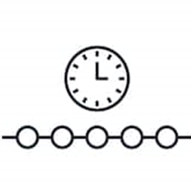
Iteration 1: Data Processing – Findings, Challenges & Methodology
Unreasonable Data
Presence of data points which make no chronological sense
Changing Medical Standards
Changes in medical standards over the years makes data formats inconsistent
Censored Data
No full dataset for patients to calculate 10 years statistics
Levels of Detail
Many medical rules to group categories and sub-categories. This was worsened by inconsistent data granularity
ITERATION 1
Notes:
1) No full dataset for 5-10 years
2) Less enforcement of collection of data
3) Changing medical standards
4) Unclean data. Period of time where datetime is wrong
5) Levels of detail
Data limitation
Not enough data (e.g. very few patients with 10 years of record)
Model interpretability
Presenting the results and insights of the model in an understandable way
Model accuracy evaluation
Determining the most suitable evaluation method for our problem (e.g. confusion matrix, AUR-ROC)
Lack of model variability
Overfitting or underfitting the data (e.g. capturing noise)

Slide 15
Unreasonable Data
Eg:
Patient who gets breast cancer at 3 years of age
Patient who have a date of death earlier than date of birth
Patient with 27 children
Patient with menopause at age of 8
Patient with menstruation at age of 3
Patient born in 2020 (We received data in 2019)
We have worked with NCCS to retrieve a new set of clinical data on 5 Feb 2020 (Version 3).

Slide 16
Changing Medical Standards
Continuous development of medical standards changes the ways patient details are recorded.
Year | Version
1977 | AJCC Cancer Staging Manual (1st ed.)
1983 | AJCC Cancer Staging Manual (2nd ed.)
1988 | AJCC Cancer Staging Manual (3rd ed.)
1992 | AJCC Cancer Staging Manual (4th ed.)
1997 | AJCC Cancer Staging Manual (5th ed.)
2002 | AJCC Cancer Staging Manual (6th ed.)
2009 | AJCC Cancer Staging Manual (7th ed.)
2016 | AJCC Cancer Staging Manual (8th ed.)

Slide 17
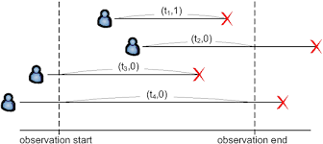
Nature of Medical data - Censored Data
Censoring is a condition in which the value of a measurement or observation is only partially known
Patient withdraw halfway during treatment

Slide 18
Nature of Medical data - Censored Data
No full dataset for patients to calculate 10 years statistics
E.g. Patient diagnosed in 2018 will only have 1 year of data (as of 2019). Unable to get a ground truth on what his 2 years cost is going to be.
Implementation of different designs to overcome this in cost and survivability calculation

Slide 19
Levels of Detail
There are a lot of derived fields in the patient’s clinical data.
T1
T1a
1
5
T1b
6
T Staging (Lower)
T Staging (Upper)
Tumour Size (mm)

Slide 20
Iteration 2: Building Cost Prediction Model

Slide 21
Cost - Blackbox
Input Data
Age
Tumour size
T, N, M stage
ER
PR
HER2
No. of positive nodes
Black Box
Machine Learning Models:
Cost Prediction
Survival Prediction
Feature Selection
Cost Prediction
{“1st Yr”: “$x”,
… ,
“10th Yr”: “$x”}

Slide 22
Cost Predictions
 | Original | 1 year | 2 Year | 5 year | 10 Year
No. Obsv. | 16,127 | 15,518 | 14,552 | 10,954 | 5,762
4 separate models were created due to the difference in number of data we have for each time period
Model 1: 1 year
Model 2: 1 year, 2 year
Model 3: 1 year, 2 year, 5 year
Model 4: 1 year, 2 year, 5 year, 10 year
A substantial amount of data have this problem where they only start having costs a few years after initial diagnosis.
Before 6m | After 6m | After 1y | After 2y | After 3y | After 4y | After 5y | After 6y | After 7y | After 8y | After 9y | After 10y
0.00 | 0.00 | 0.00 | 0.00 | 0.00 | 8699.92 | 0.00 | 7524.66 | 6205.28 | 5540.45 | 5255.93 | 311.78

Slide 23
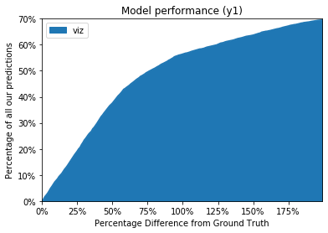
Model Performance Evaluation
% of our predictions
50% of our predicted values are at within 75% of actual costs
% difference from actual data

Slide 24
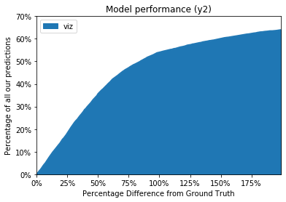
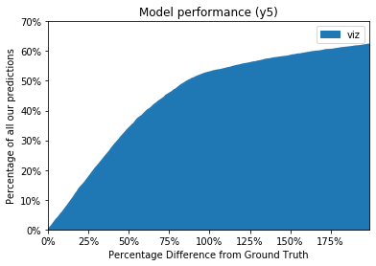
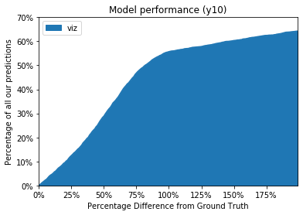
Cost Prediction Evaluation
Predictions are best for Model 1, followed by Model 2, then Model 3, and finally Model 4
Model 1: 1 year
Model 2: 1 year, 2 year
Model 3: 1 year, 2 year, 5 year
Model 4: 1 year, 2 year, 5 year, 10 year
Model 1
Model 2
Model 3
Model 4

Slide 25
Iteration 2: Building Survival Model

Slide 26

Survival – Features Selection
Input Data
Age
Tumour size
T, N, M stage
ER
PR
HER2
No. of positive nodes
Black Box
Machine Learning Models:
Cost Prediction
Survival Prediction
Feature Selection
Feature Sel.
{“x1 Weight”: 0.02 +- 0.01,
… ,
“xn Weight”: 0.02 +- 0.01}

Slide 27


Survival – Feature Selection (FS)
Feature selection for Cox model
Fit a Cox model to each features individually and record the Concordance index on the training set. Use pipeline grid search to find optimal cut off point
Feature selection for RandomSurvivalForest
Permutation Importance from ELI5 library to find the magnitude of the log-rank test statistic
Features | C-index
Size of Tumour | 0.701729
# of nodes | 0.668167
Age | 0.600119
… | …
… | …
Features | Weight
Age | 0.0285 ± 0.0052
# of nodes | 0.0090 ± 0.0063
Size of Tumour | 0.0042 ± 0.0052
… | …
… | …
Domain Knowledge from doctors
Our Model Input!

Slide 28

Survival – Prediction
Input Data
Age
Tumour size
T, N, M stage
ER
PR
HER2
No. of positive nodes
Black Box
Machine Learning Models:
Cost Prediction
Survival Prediction
Feature Selection
Surv Prediction
{“P(surv|t=1)”,
… ,
“P(surv|t=10)”}

Slide 29

Survival Model - Findings
Dataset used by NCCS’s Kalpan-Meier uses most patient records without filtering
i.e. for patient that has only 2 months of diagnosed record, this instance might not be useful for 1 year prediction.
Our Action
Filtering such right censor according to our years of interest

Slide 30
Survival Overview – Model & Patient Population
1. Cox (Proportional Hazards) Regression
Assume predictor variables (x features) upon survival are constant over time, degree dispensed consistently and have significant outcome
2. Sklearn RandomSurvivalForest (RSF)
Each trees are de-correlated
Built on different bootstrap sample
Predictions are formed by aggregating predictions of individual trees in the ensemble
Years of Data | Survival Category | # of Patients
1 | DFS | 14,946
 | CSS | 15,118
 | OS | 15,118
5 | DFS | 2,816
 | CSS | 2,867
 | OS | 2,867
10 | DFS | 2,785
 | CSS | 2,785
 | OS | 2,785
DFS: Disease Free Survival
CSS: Cancer-Specific Survival
OS : Overall Survival

Slide 31

Models Comparison
Cox Regression
Easy to interpret
Linear model
Average Performance
Most popular survival model
Hazard ratio
RandomSurvivalForest
Hard to interpret nodes
Ensemble of tree-based learners
Better performance
Most promising performing model
Cumulative Hazard(%)
Notes:
The c-index is "A measure of goodness of fit for binary outcomes in a logistic regression model.“
For traditional regression, impurity would be measured by the variance, but for survival analysis there is no per-node impurity measure due to censoring. Instead, one could use the magnitude of the log-rank test statistic as an importance measure, but scikit-learn's implementation doesn't seem to allow this.
In survival analysis, the hazard ratio (HR) is the ratio of the hazard rates corresponding to the conditions described by two levels of an explanatory variable. For example, in a drug study, the treated population may die at twice the rate per unit time as the control population. The hazard ratio would be 2, indicating higher hazard of death from the treatment. Or in another study, men receiving the same treatment may suffer a certain complication ten times more frequently per unit time than women, giving a hazard ratio of 10.

Slide 32
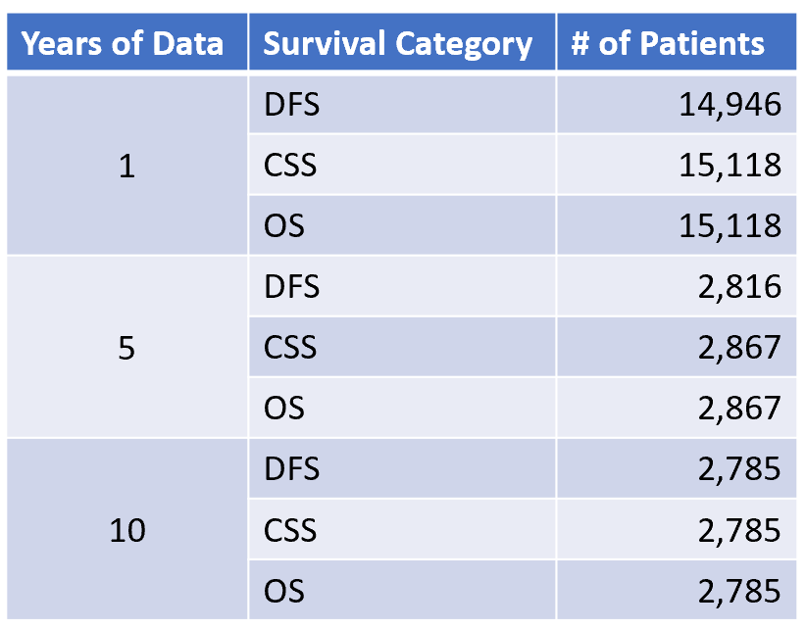
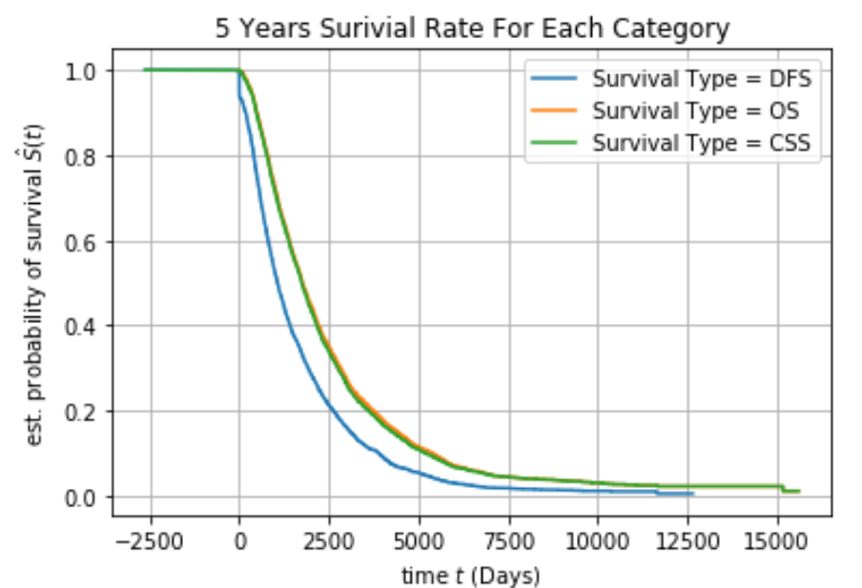
Survival - X & Y Features for Prediction
X Features:
Y Features:
Age
Tumour size
T, N, M stage
ER
PR
HER2
No. of positive nodes
Status (Dead/Alive)
Survival in days**
Category: OS
Right censored ( 1 years of record)

Slide 33

Survival Model Performance Evaluation
Harrell's concordance index
Generalization of the area under the receiver operating characteristic (ROC) curve
a value of 0.0 denotes a perfectly wrong model.
a value of 0.5 denotes a random model,
a value of 1.0 denotes a perfect model.
Model | Score
Cox Regression | 0.79647
RandomSurvivalForest | 0.79883
The models are more than mere random model!
Notes:
The most widely used performance measure is Harrell's concordance index. Given a set of (predicted) risk scores and observed times, it checks whether the ordering by risk scores is concordant with the ordering by actual survival time.

Slide 34

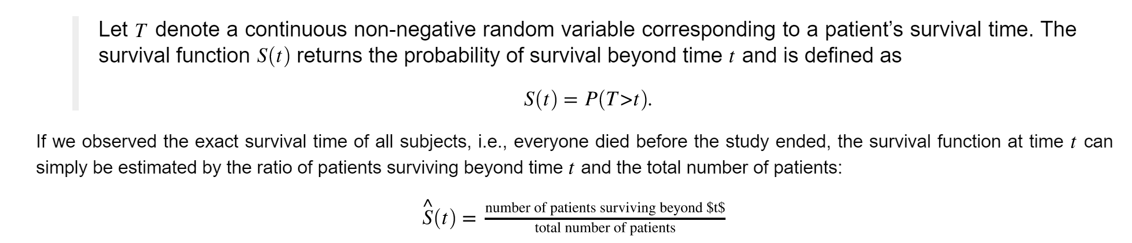
Survival Model Evaluation - Formulae
Cox Regression accuracy tolerance (tol) : default: 1e-8
Formulae:
abs(1 - (new neg. log-likelihood / old neg. log-likelihood) ) < tol
Likelihood:

Slide 35


Limitation of Harrell’s Concordance Index and Mitigation Plan
Our data is subjected to censoring, therefore, performance measures need to account for censoring.
While Harrell's concordance index is widely used, it has its flaws, in particular when data is highly censored.
Mitigation Plan
Continue to work closely together with NCCS to find out the optimal tolerance level for censoring.
E.g. instead of using all patient population, use only patient with more than 2 years of record

Slide 36
C.A.R.E Application Prototype

Slide 37

Persona
Persona 1: Dr. Tea Party
Surgical Oncologist, working in NCCS for 5 years
Hold consultation sessions with breast cancer patients: explain procedures & information on short-term treatments
Estimate patients’ survival rates (In-built app) during consultation
Pain points: In-built app is unable to predict survival rates, Patients are unable to understand charts (cause miscommunication)
Persona 2: Mr(s). Bean
Senior Financial Counsellor, working in NCCS for 4 years
Provides financial advice to patients and their next-of-kin (Briefs them on short-term estimated costs for treatment & cost breakdown)
Pain points: Unable to forecast patient’s future/overall cost. S(He) lacks time to individually manage each patient’s finances due to increase in tasks

Slide 38



Use Case Summary
User | Details
Patient | Goh Yakun - Has stage 1 breast cancer and just had breast surgery. Cancer Inputs: Age @ Dx 21, Tstage - Tis, ER Positive, PR Positive, Her2 Negative, Size Precise = 1.3, Node Pos = 0, Nstage - N0, Mstage - M0
Surgeon | 1. While waiting for Patient, Surgeon reads descriptive charts from summary dashboard 2. When patient arrives, Surgeon fills in the patient’s cancer results in calculator form 3. App displays result charts in results page, based on cancer inputs 4. To explain patient’s survival rates, Surgeon goes ‘Patient View’ tab & summarises information using UI-friendly charts 5. Surgeon simplifies charts in ‘Doctor View’ - displays complex prediction charts based on patient’s biopsy
Financial Counsellor | 1. During consultation, Counsellor fills in patient’s results in calculator form with information from Surgeon’s memorandum 2. Under “Cost Prediction” Tab, financial cost prediction is generated and displayed

Slide 39
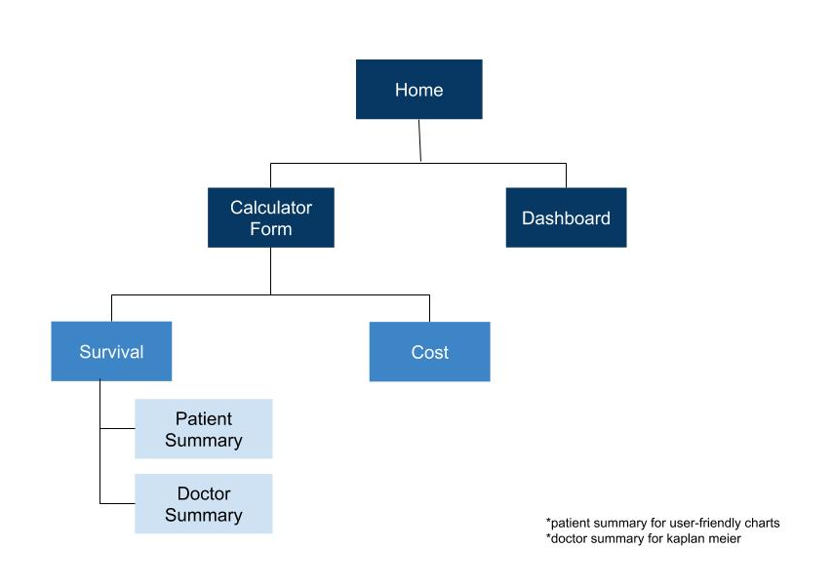
Navigation Diagram

Slide 40

Scenario Demo
Notes:
https://www.youtube.com/watch?v=Lt25vwMvKRI&feature=emb_title

Slide 41
Future Work

Slide 42
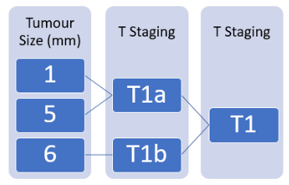

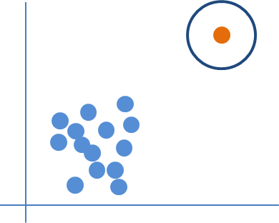


Future Work
Explore different levels of details
Expand feature importance exploration
Explore alternate strategies to process outliers
Interactive user interface and web layout
Non-negative matrix Factorization for Cox Regression
Dimensionality reduction, source separation, topic extraction
(Tertiary)
Notes:
Our future work moving forward would be to achieve better accuracy for our models and provide more meaningful results for patients. For the ANN model and survival prediction model, we would like to explore different levels of details. As we mentioned previously, we have different levels of data with different number of available records. We have lesser records that have high granularity becayse those details wasnt recorded in the past. So, we would like to train the different permutations of levels of data and see whether we can find the best level of data for the model. Next, we would like to expand our feature importance exploration to find whether there are any other features that contribute significantly to our model prediction. We would also like to explore alternate strategies to process outliers. For example, a patient can spend a lot in the first year, then very little seubsequently. We need to find a way to process outliers so that we don't lose important information For UI, we will improve the interactive-ness of our web interface. Lastly, if we have additional time, a tertiary function we can explore is non-negative matrix factorisation for cox regression. (dimensionality reduction, source separaation, topic extraction)
To achieve better accuracy
Meaningful results for patients
Interactive user interface and web layout
Explore all levels of details:
Find optimal level of details for ANN model
Find optimal level of details for survival prediction model
Expand feature importance exploration
Explore strategies to process outliers
(Tertiary) Non-negative matrix factorization (dimensionality reduction, source separation, topic extraction)

Slide 43
References:
Icons: https://www.flaticon.com/authors/freepik
Cox Model: https://www.statsdirect.com/help/survival_analysis/cox_regression.htm
Research Reference: https://projecteuclid.org/euclid.aoas/1223908043
Project Motivation: https://www.straitstimes.com/opinion/new-ways-to-fund-better-long-term-care

Slide 44
Annex

Slide 45
Annex Catalogue
Annex A: Project Background and Motivation
Annex B: Project Management (Requirements, Plan, & Work Distribution)
Annex C: Iteration 1 – Data processing
Annex D: Iteration 2 – Machine Learning Models
Annex E: Persona & Use Case

Slide 46
Annex A: Project Background & Motivation
National healthcare spending in Singapore has almost tripled from $3.74 billion in 2010 to $9.8 billion in 2016 (2.2% of GDP). This is projected to reach $13 billion in 2020 (Basu, 2017). This unsustainable rate of increase is especially evident in cancer care. Major advancements in cancer diagnostics and treatment have led to significant improvements in clinical outcomes. However, the cost of therapy, including chemotherapy, targeted agents, and more recently, immunotherapy and proton therapy, is substantial and have contributed to some of the largest and most rapid increase in healthcare spending.
In seeking to control these unsustainable increases in healthcare costs, it is imperative that healthcare organizations can predict the likely future costs of individuals, so that management resources can be efficiently targeted to those individuals at highest risk of incurring significant costs. For the patient and their family, having advanced knowledge of expected healthcare expenses allows them to prepare financially and emotionally and to make rational healthcare decisions to maximize value.

Slide 47
Annex A: Project Background & Motivation
What will this mean to our stakeholders?
Improvements in:
1) patient satisfaction &
2) communication process regarding diagnosis & treatment selection.
This app will be deployed for financial counselling for specific procedures, and short & long term overall expenditure and also in clinics for medical consultations with doctors, allied health personnel and medical social workers.

Slide 48
Annex B: Project Management (Requirements - Refined)
Core (Primary) functions
Initial Proposal Module | Remastered Modules | Functions
Machine Learning Regression Module | Cost Prediction Module | Trainable model based off suitable Machine Learning/AI models. Predict patient treatment cost (1,2,5,10 years)
 | Survival Prediction Module | Trainable model based off suitable Machine Learning/AI models. Predict clinical outcomes (5,10 years)
Machine Learning Clustering module | Clustering Module ➔ Feature Selection | Clustering/bagging module Cluster patients to improve regression accuracy Explore feature importance beyond clinical knowledge
Descriptive Analytics Module | <As Proposed> | Generate summary statistics of selected patient groups Generate summary statistics of general population
NCCS Survival module | Kaplan Meier Module | Calculate OS, DFS, CSS of patients
Visualisation module | <As Proposed> | Generate visualisations based on Regression, survival, & Descriptive Analytics module output
User Interface (Ui) module | <As Proposed> | Home page Patient cost & Clinical outcome predictor page 1, 2, 5, 10 year views (cost). 5, 10 year views(clinical)

Slide 49
Annex B: Project Management (Work Hours)

Slide 50
Annex B: Project Management (Work Hours)
Global Team Stats:
 | Week Count | 8
Total | Cumulative Work Hours | 553
 | Member Average Hours (Total) | 92.2
Weekly | Member Average Hours/Week | 11.5
 | Group Average Hours/Week | 69.1

Slide 51
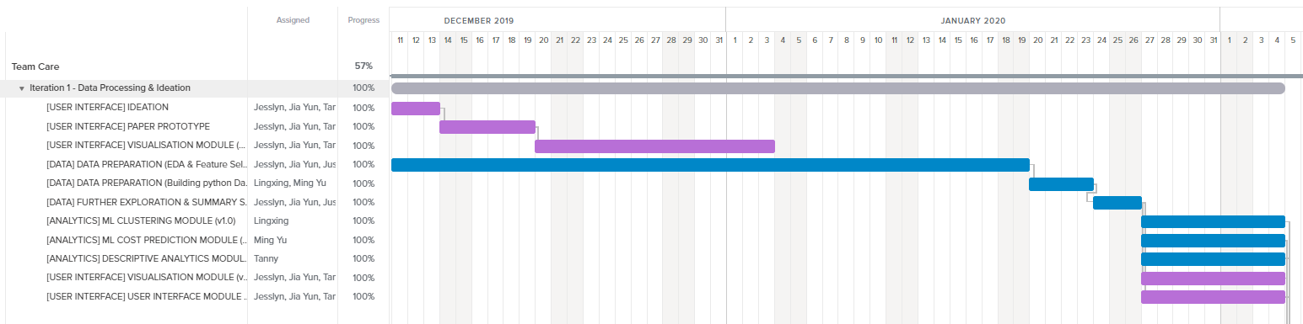
Annex B: Project Management (Gantt Chart)
For detailed Overview, access via TeamGantt (Access given to Prof. Akshat Kumar)
Gantt Chart: Iteration 1

Slide 52
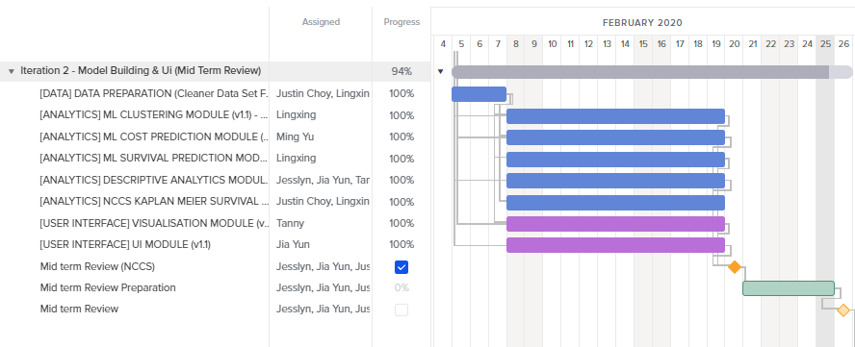
Annex B: Project Management
Gantt Chart: Iteration 2

Slide 53
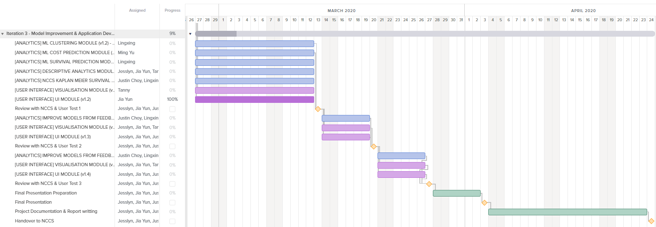
Annex B: Project Management
Gantt Chart: Iteration 3

Slide 54
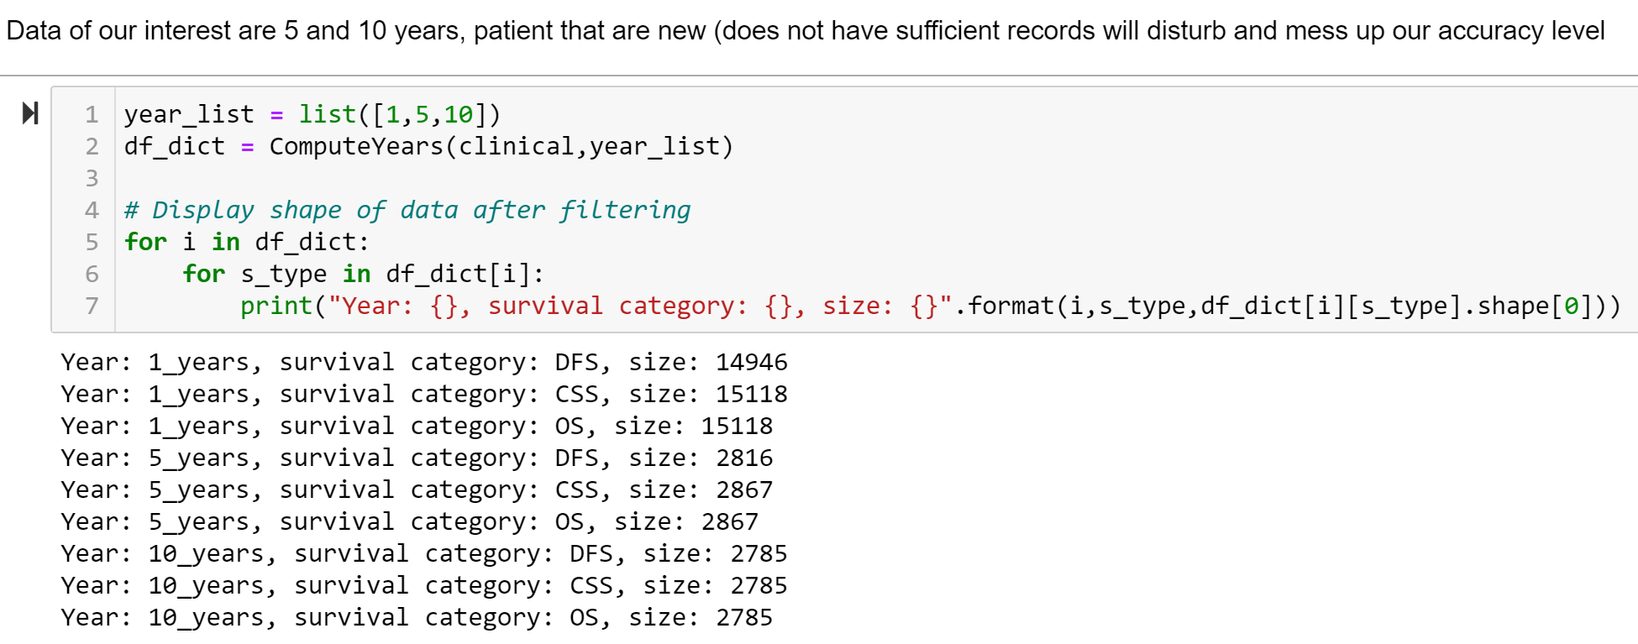
Annex C: Iteration 1 – Data processing

Slide 55
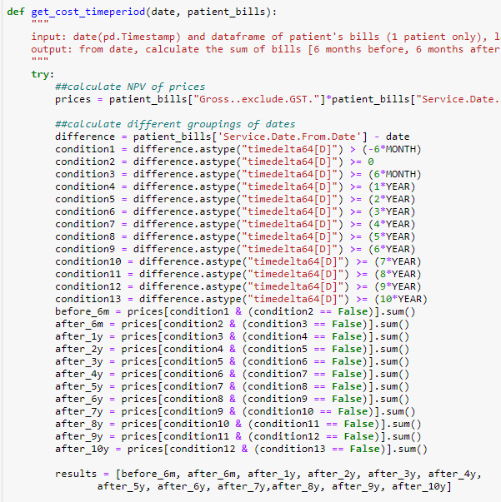
Annex C: Iteration 1 – Data processing
Code can be found on Github: https://github.com/cmy96/fyp
Calculation of net present value of bills:
(Gross cost of bill) * (1+ Interest rate) ^ (Current year – year of bill)
Given patient’s diagnosis date(dx date), sum all bills within these time frames:
6 months before dx date – dx date
Dx date – 6 months after dx date
6 months after dx date – 1 year after dx date
1 year after dx date – 2 year after dx date
...
9 year after dx date – 10 year after dx date

Slide 56
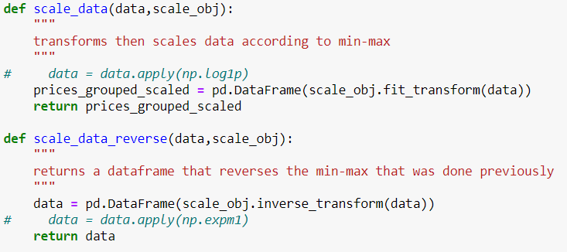
Annex C: Iteration 1 – Data processing
Costs were scaled according to this formula
X_std = (X - X.min(axis=0)) / (X.max(axis=0) - X.min(axis=0))
X_scaled = X_std * (max - min) + min
Considered using log transformation since we know that healthcare costs can be left skewed, but this did not work out as it tended to cause results to consistently be small

Slide 57
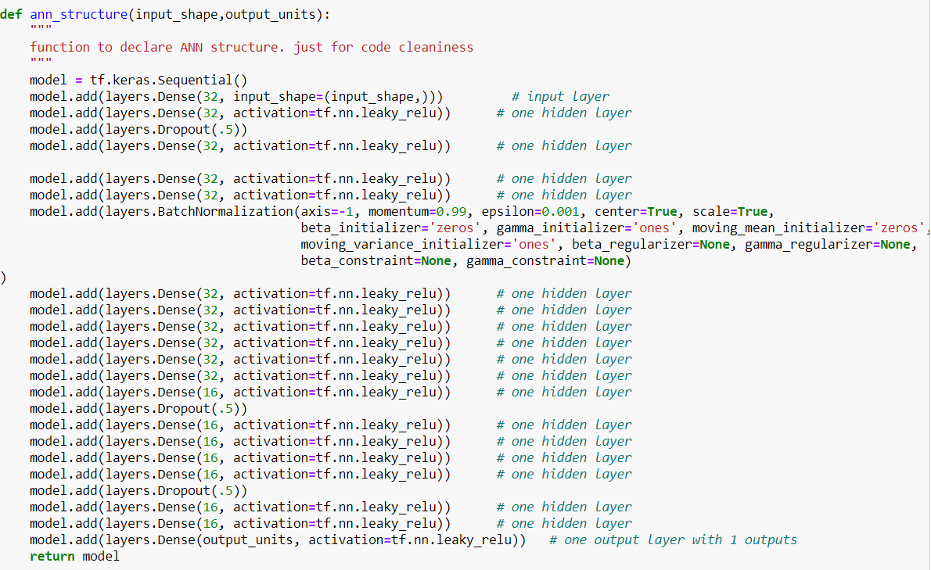
Annex D: Iteration 2 – ANN

Slide 58
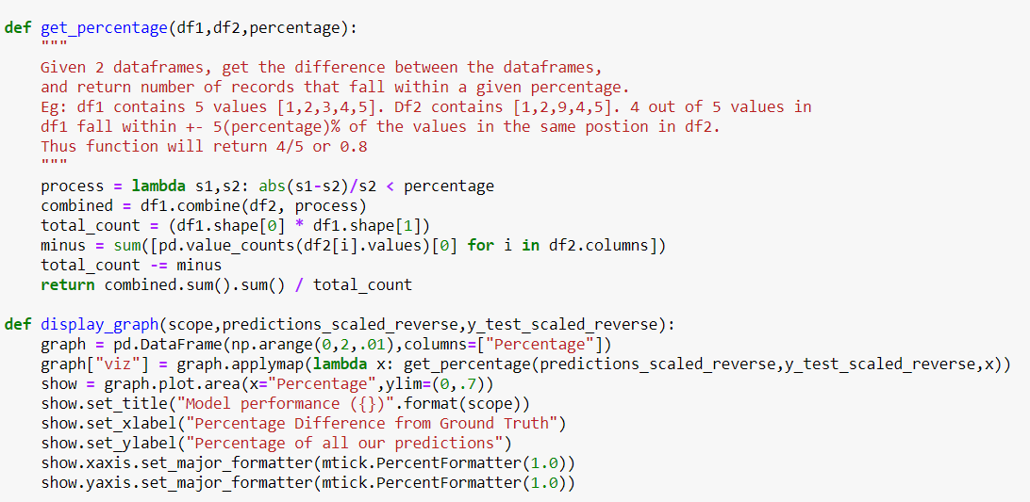
Annex D: Iteration 2 – ANN evaluation graph

Slide 59
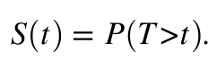
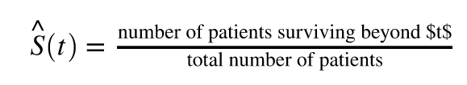
Annex D: Iteration 2 – The Survival Function
Let T denote a continuous non-negative random variable corresponding to a patient’s survival time. The survival function S(t) returns the probability of survival beyond time t and is defined as
survival function at time t can simply be estimated by the ratio of patients surviving beyond time t and the total number of patients:

Slide 60
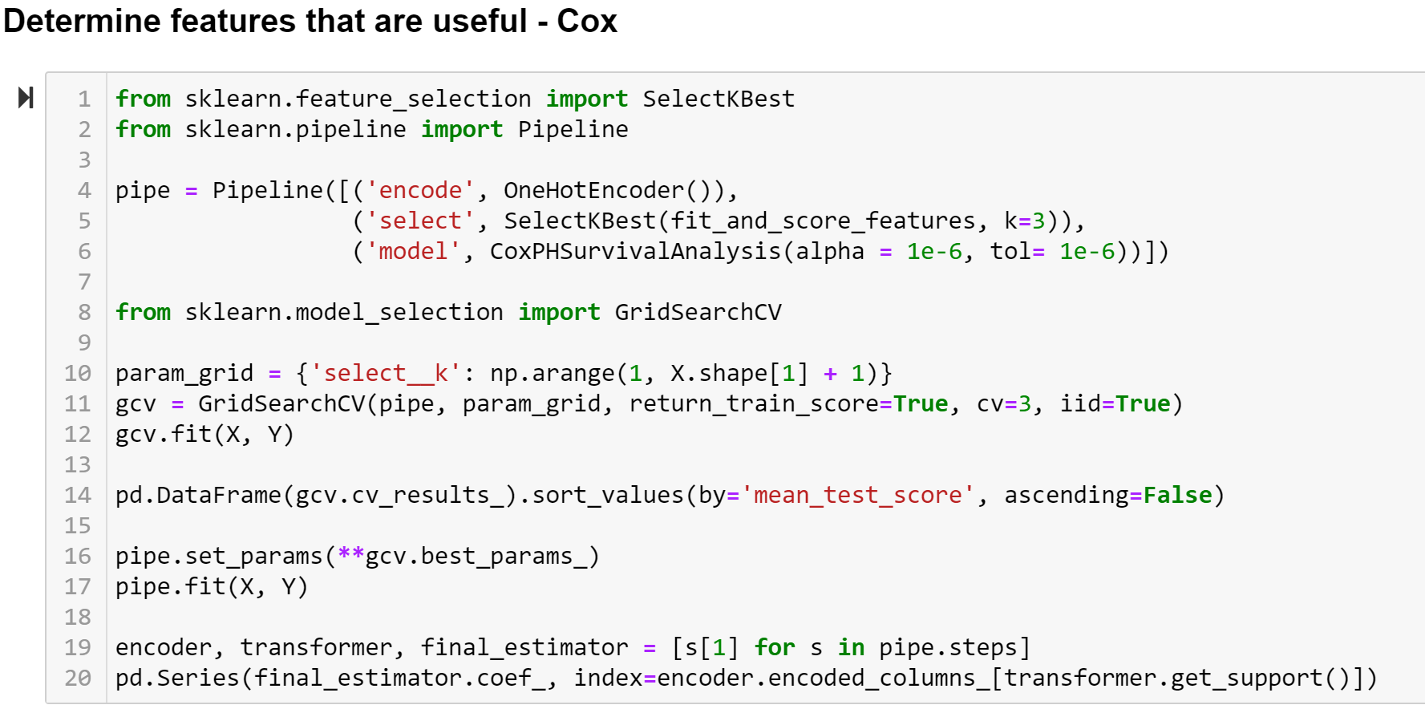
Annex D: Iteration 2 – Features Selection code

Slide 61
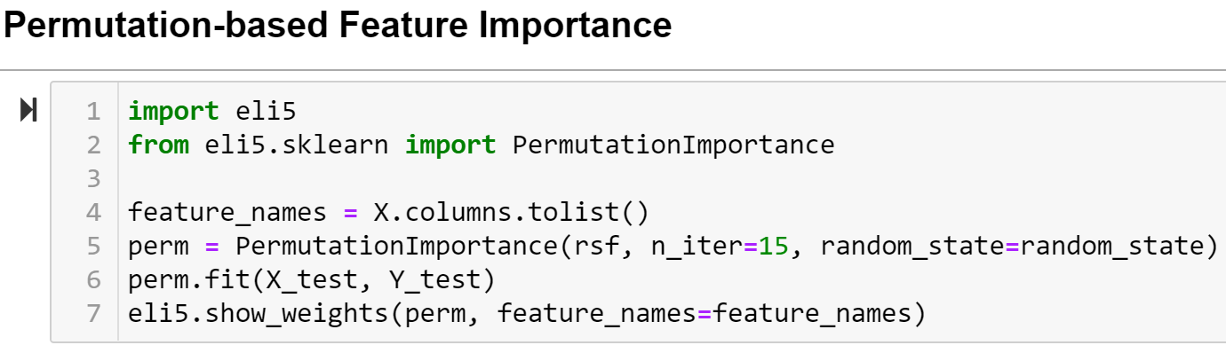
Annex D: Iteration 2 – Features Selection code

Slide 62
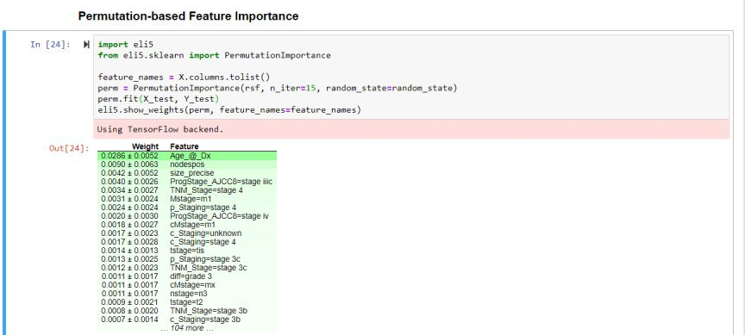
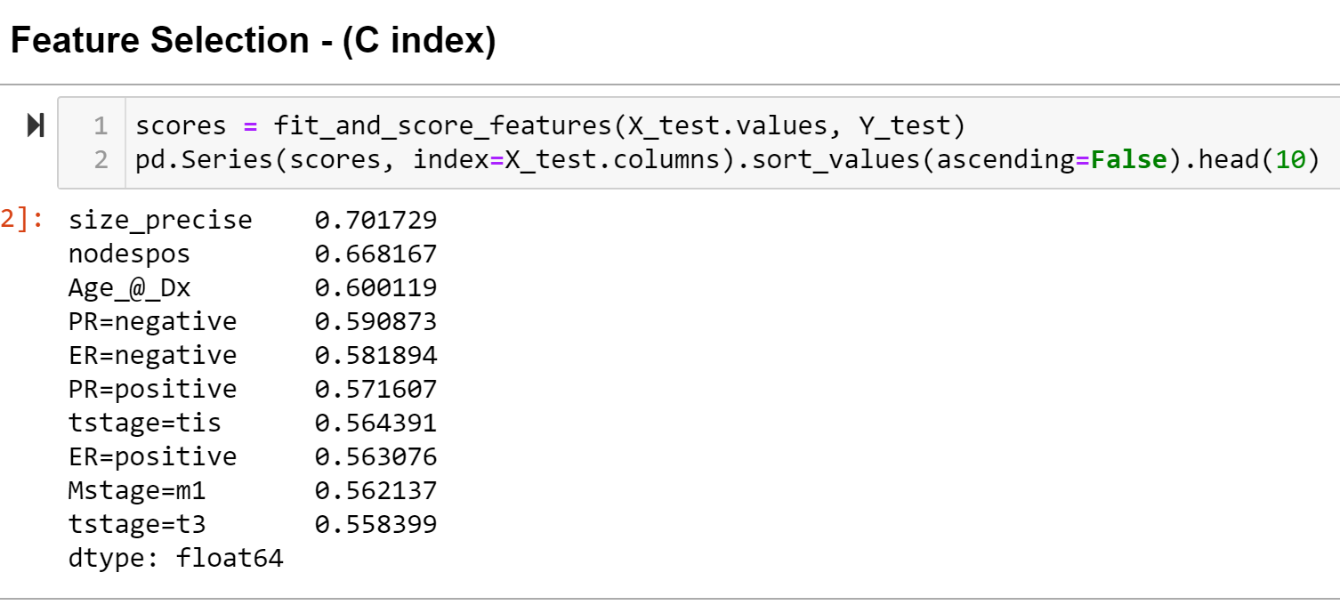
Annex D: Iteration 2 – Features Selection

Slide 63
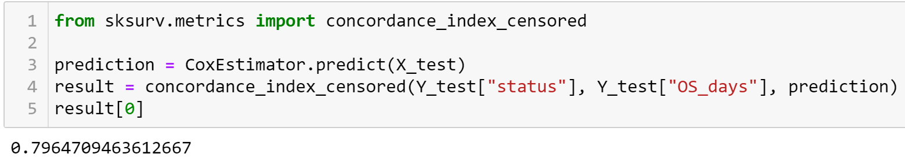
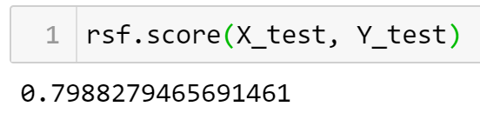
Annex D: Iteration 2 – Survival Evaluation
Cox Regression
RandomSurvivalForest

Slide 64
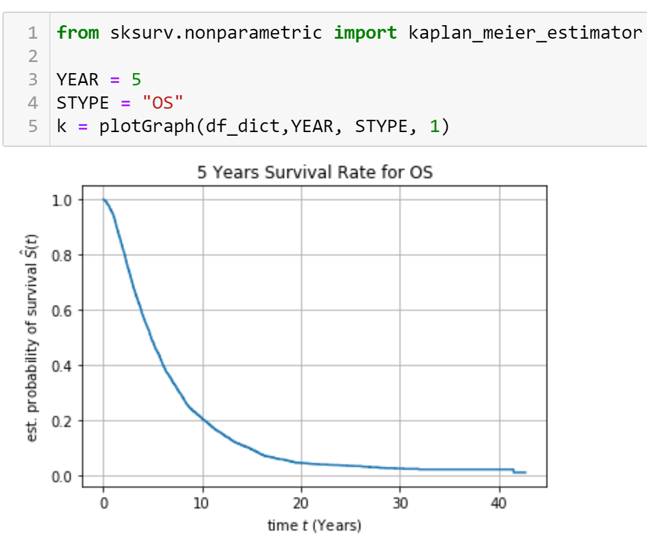
Annex D: Iteration 2 – Kaplan Meier

Slide 65
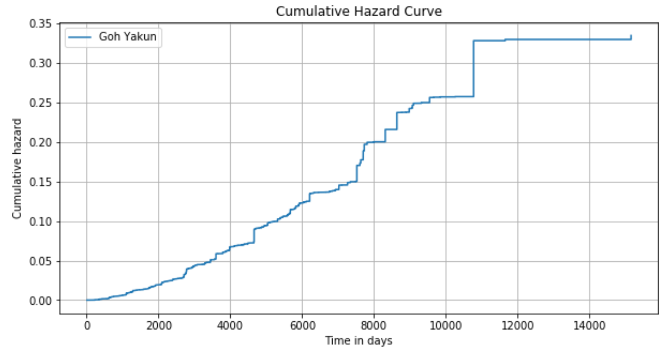
Annex D: Iteration 2 – Cumulative Hazard Curve

Slide 66
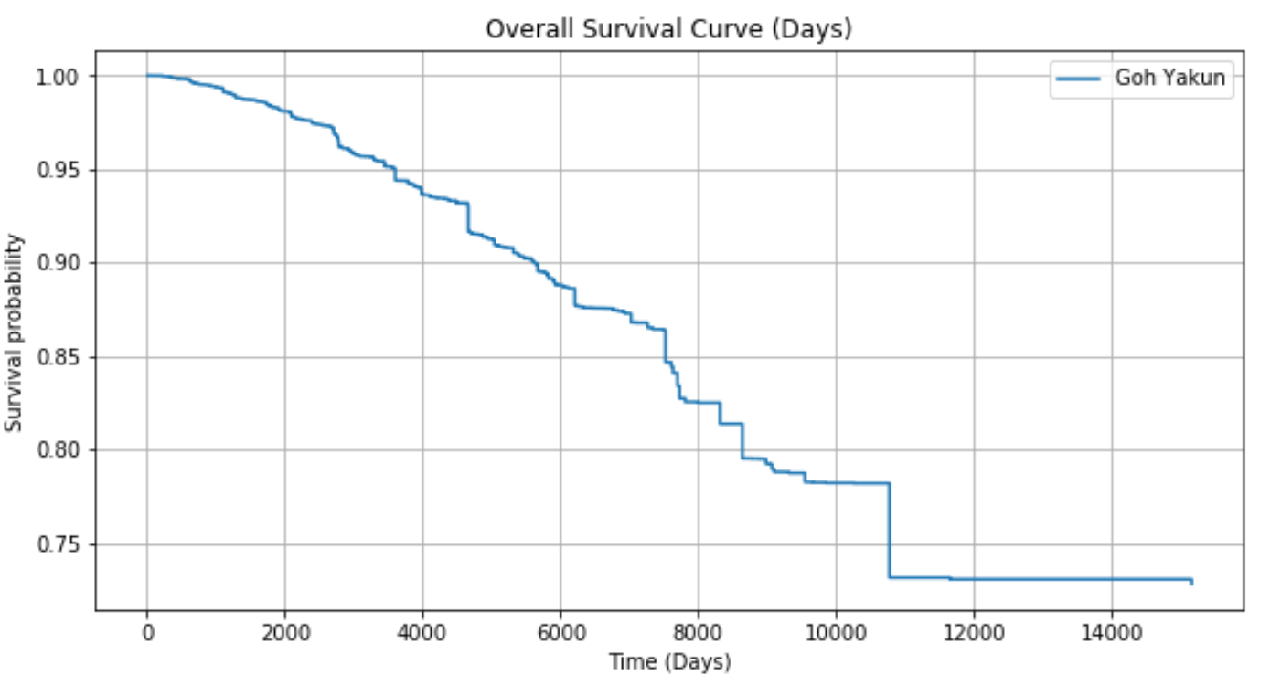
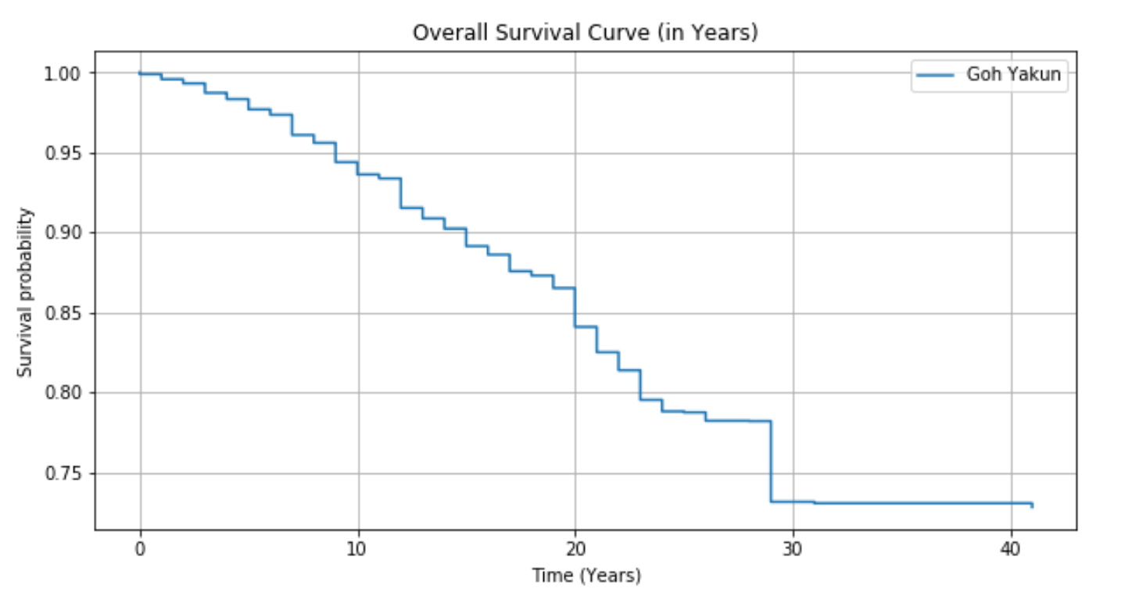
Annex D: Iteration 2 – RSF prediction

Slide 67
Annex E: Persona
Persona 1: Dr. Tea Party
Surgical Oncologist, working in NCCS for 5 years. He holds consultation sessions with breast cancer patients before and after the surgery to explain the procedure and provide information about short-term treatments to patients. Dr. Tea utilizes an in-built Survival Web Application to estimate patients’ survival rates during consultation. Pain points: Patients are unable to understand the built-in charts and calculations, as a result, causing miscommunication.
Persona 2: Mrs. Bean
Senior Financial Counsellor, working in NCCS for 4 years. Bean is responsible for providing financial advice to patients and their next-of-kin – briefs them on total estimated costs of treatment and cost breakdown for the suggested treatment plan based on his financial management expertise and his patient’s finances. Pain points: He is unable to forecast future and total cost. He lacks time to individually manage each patient’s finances due to an increase in tasks.

Slide 68
Annex E: Use Case Scenario
Surgeon: I will be having a consultation with Goh Yakun, who has stage 1 breast cancer and just had breast surgery. While waiting, I read the charts from the summary dashboard of the CARE app. Yakun arrives and I navigate to the calculator form to fill in the required input using her mammogram results. Upon submission, the application redirects me to the results page, where an analysis of her condition is presented in charts. To explain to Yakun her condition in layman’s terms, I click on the ‘Patient View’ tab, which summarises the diagnosis and analysis in user-friendly charts. Then, I click on the ‘Doctor View’ tab, which displays complex prediction charts based on the biopsy. I then explain the charts in simpler terms and provide recommendations for her future treatment plans.
Finance Counsellor: At my consultation session with Goh YaKun, I input her biopsy results into the calculator form with information from the doctor’s memorandum and click Calculate. Under the “Cost Prediction” Tab, the financial cost prediction is generated and displayed on the screen. I then explain the predicted bill size and breakdown of the costs at different time periods with the user-friendly charts generated by the CARE app.

Slide 69
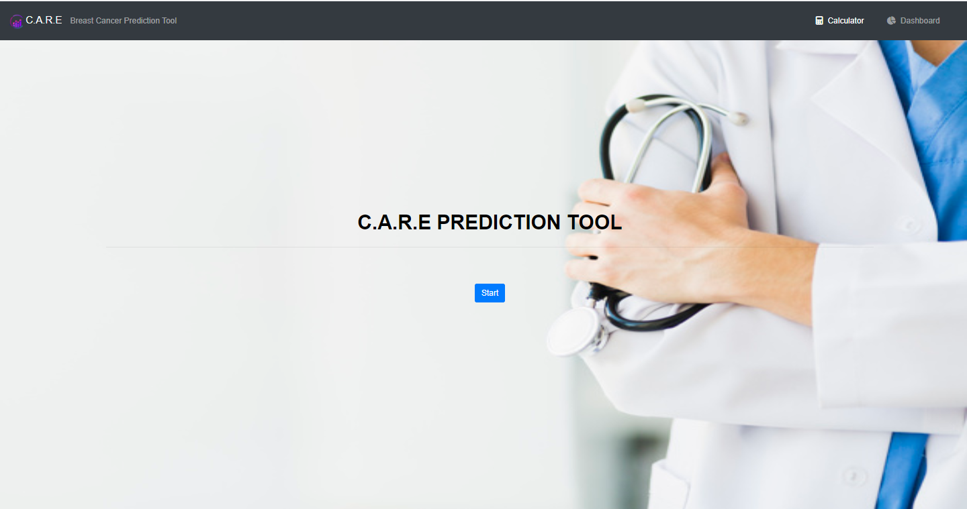
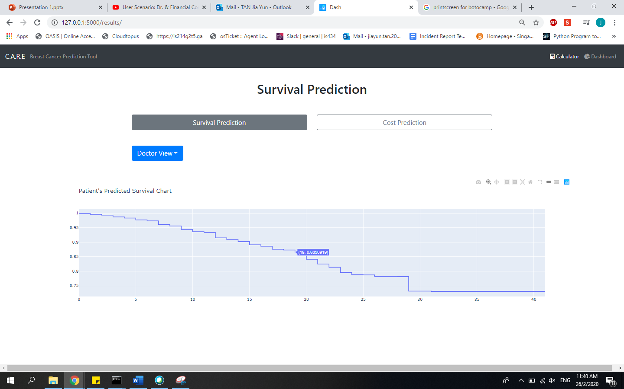
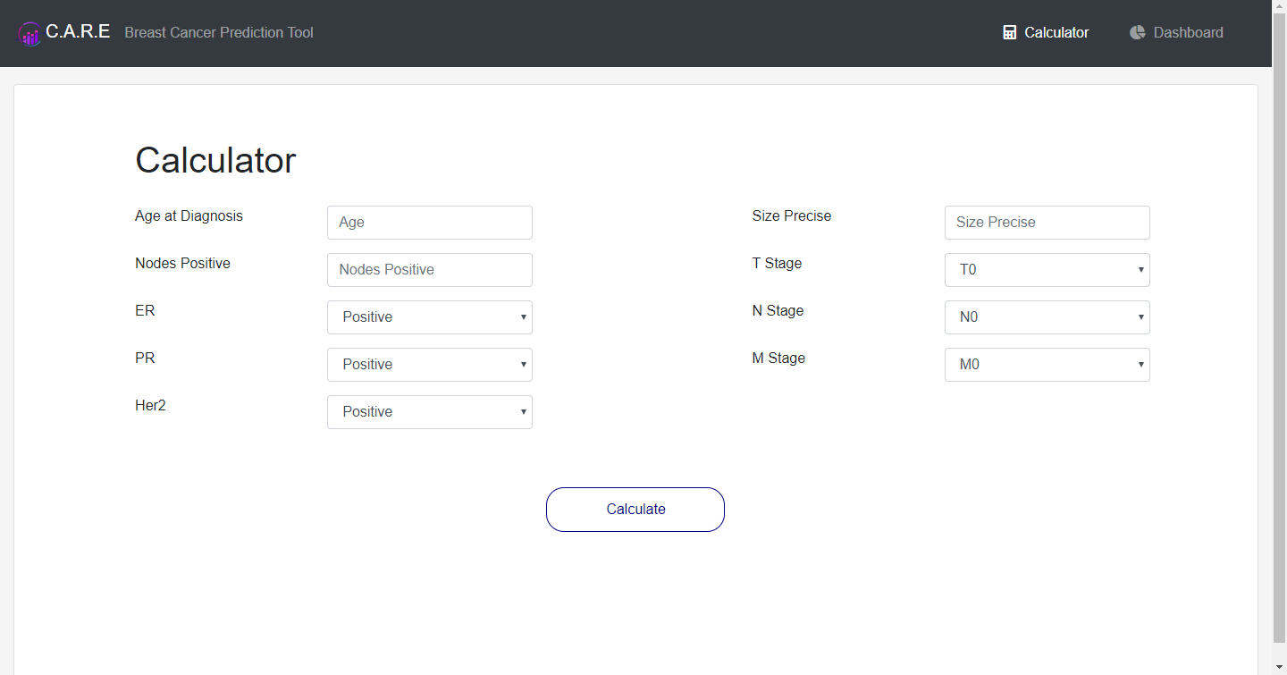
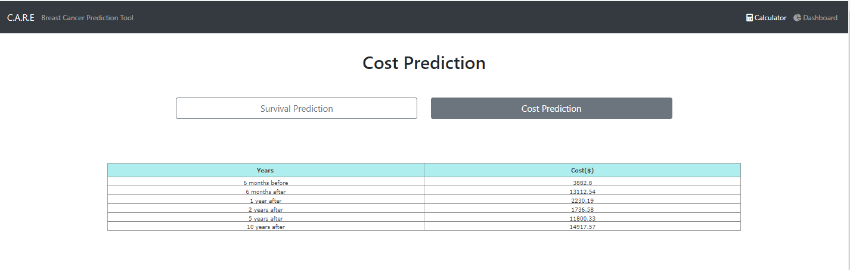
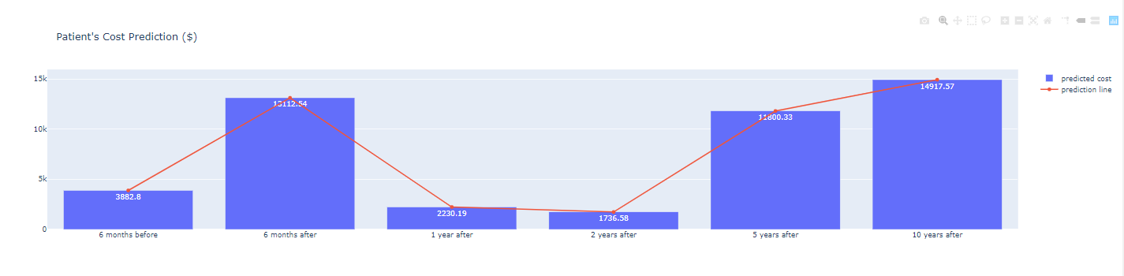
Annex F: User Interface

Slide 70
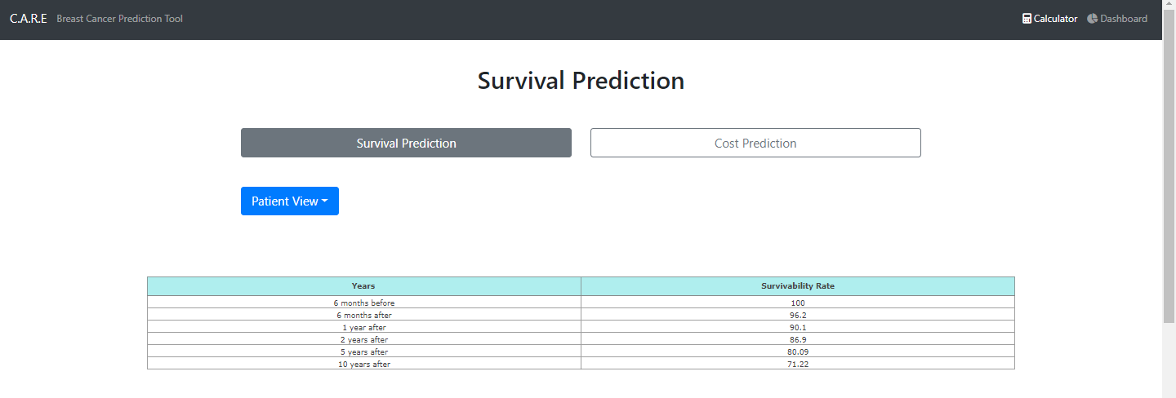
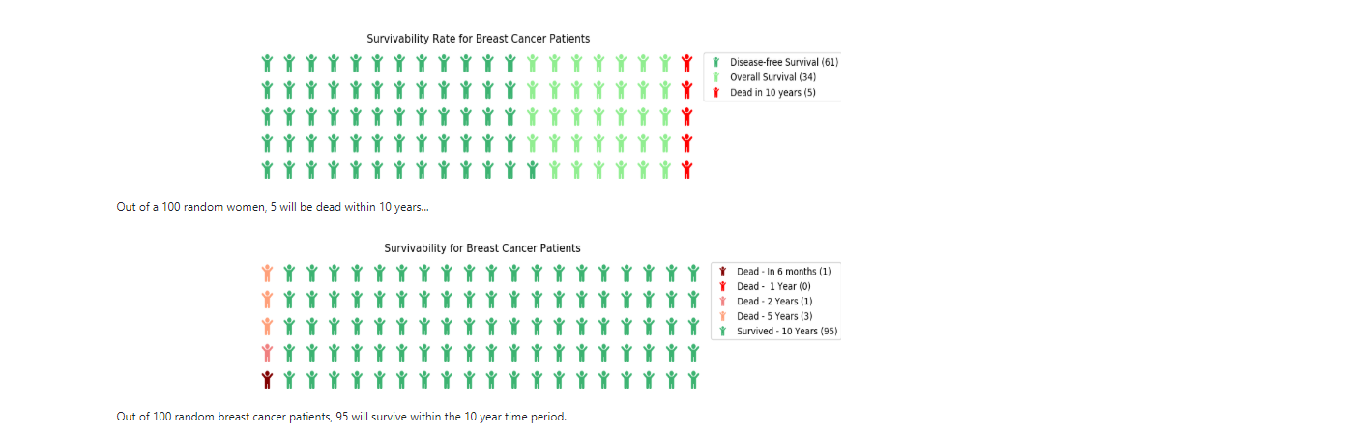
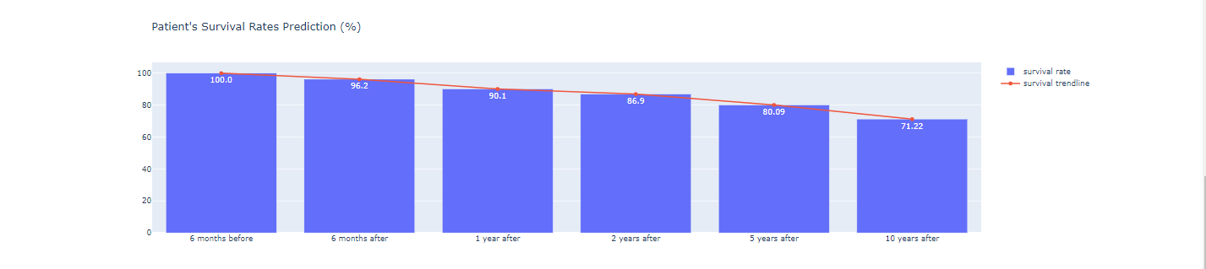
Annex F: User Interface

Slide 71
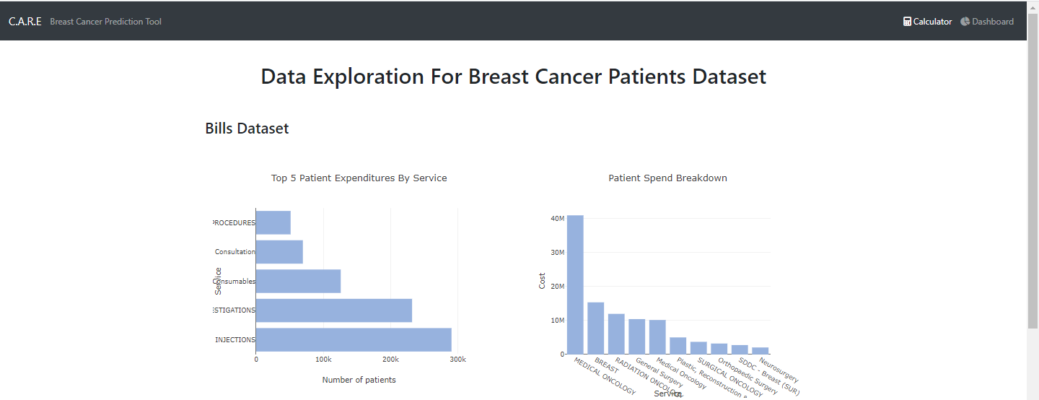
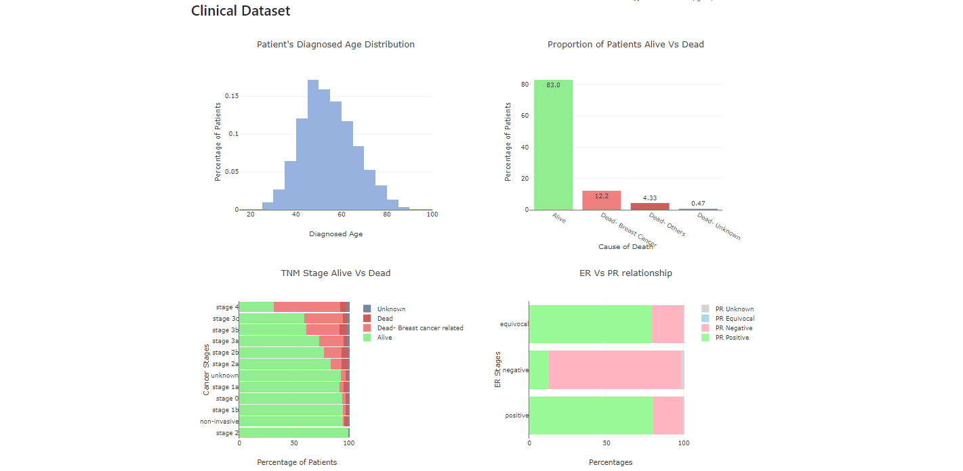
Annex F: User Interface

